Slide 1
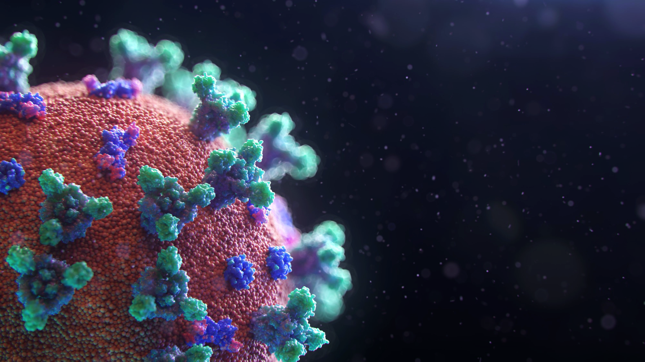
RNA based mNGS approach identifies a novel human coronavirus from two individual pneumonia cases in 2019 Wuhan outbreak
Lillian Chiang, Swathi Nadendla
Shirin Parvin, Zheyuan Zhang
EEOB/BCB 5460
May 7th, 2025

Slide 2

1
Background
Relevance of the study, Overview of NGS
Nuances of targeted manuscript
2
Workflow
Solving dependencies
NGS analysis pipeline
INDEX
3
Data / Figures
Comparisons, Learnings and Key takeaways

Slide 3
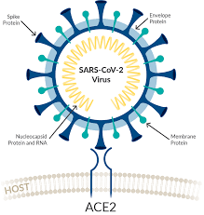
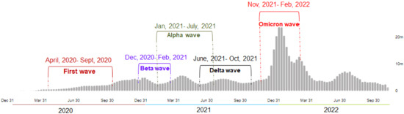
SARS-CoV-2 : Global Pandemic
Understanding coronavirus variants is crucial for rapid and effective diagnosis
Variants of concern arise as the virus mutates
Understanding these mutations helps researchers develop more accurate diagnostic tests, ensuring they can detect the virus regardless of its variant
Rapid Diagnosis and Public Health Surveillance

Slide 4
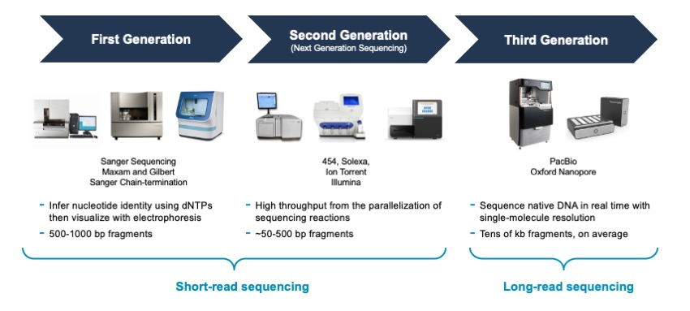
Emergence of NGS technologies
https://www.ukri.org/blog/four-milestones-powering-the-genome-sequencing-revolution/

Slide 5

What is Metagenomics??
mNGS is an unbiased method that can detect a wide range of pathogens, including novel and unexpected
How it’s relevant for SARS-CoV??
Useful for identifying transmission routes and linking outbreaks to potential sources
Plays a key role in diagnosing unculturable pathogens through conventional approaches
https://geneticeducation.co.in/a-guide-to-next-generation-shotgun-sequencing-in-metagenomics-technique-advantages-and-challenges/

Slide 6
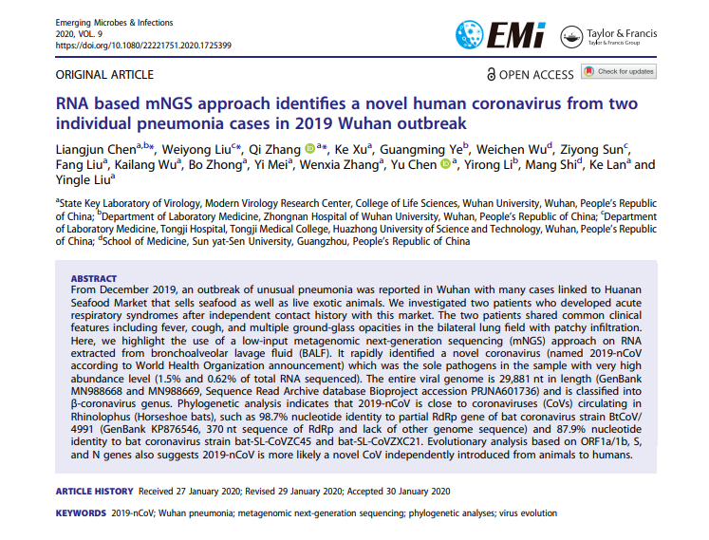
mNGS identifies a novel human coronavirus from clinical samples
This paper was chosen due to clinical relevance and impact
Final conclusions were great, but no clear pathway to replicate
Poor documentation and small sample size
A handful of bioinformatic tools
Few visualizations
Goals:
Replicate the analysis and provide detailed documentation for each step
Instead of just relying on existing tools use scripts for some parts of the analysis

Slide 7
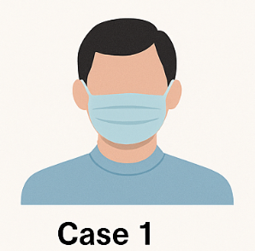

Study background
Wuhan outbreak (Dec 2019) - Linked to Huanan Seafood Market (sold seafood and exotic animals)
Case 1
39-year-old man
Case 2
21-year-old woman
Shared clinical features:​
Acute respiratory symptoms​
Fever and cough​
Bilateral ground-glass opacities on CT​

Slide 8
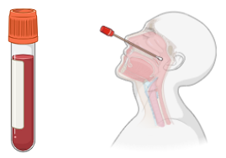
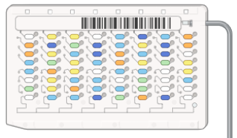
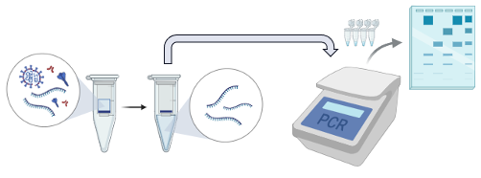
Clinical Study Workflow
Step 1: Sample Collection
Step 2: Pathogen Screening
Step 3: SARS-CoV RT-PCR Analysis
Collected respiratory and blood samples; conducted blood tests, biochemical analysis, and chest CT
Standard tests for common respiratory pathogens — all results were negative
Remaining RNA samples were tested with SARS-CoV–specific RT-PCR (two rounds); results indicated a novel coronavirus, not SARS-CoV
Notes:
Real-Time RT-PCR (Reverse Transcription Polymerase Chain Reaction) is a sensitive and fast test used for detecting the presence of specific genetic materials within a sample
Routine clinical laboratory tests for respiratory pathogens, including Influenza virus,pneumonia yieled negative Pneumonia etc were all negative

Slide 9
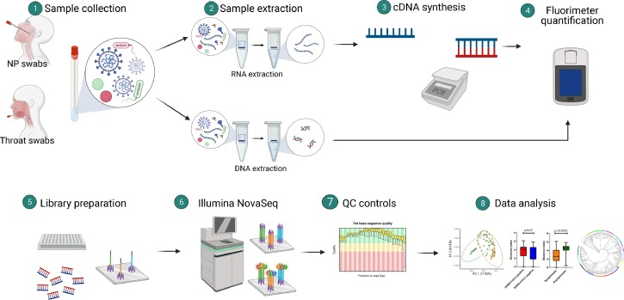
Workflow for mNGS

Slide 10
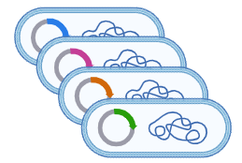

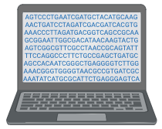
Data pre-processing
Pathogen discovery pipeline on individual reads was carried out on sequenced data (human genome taken out using Bowtie2)
Majority of reads (99.9% and 99.7%) were associated with coronavirus
Raw sequence data minus human genomic information was uploaded to the Sequence Read Archive (NCBI)
Where our analysis starts

Slide 11
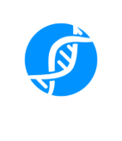
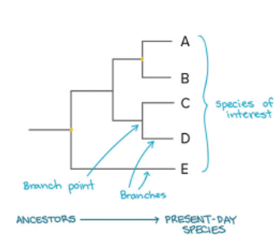

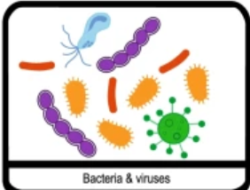
Analysis Pipeline
QC
Assembly
Taxonomy
Phylogenetics

Slide 12





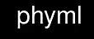



Starting out
Patient raw data sequences: NCBI Sequence Read Archive / European Nucloetide Archive (PRJNA601736)
Viral reference database from NCBI
Micromamba environment
fastp, seqtk, megahit, bowtie2, samtools, blast+, mafft, kraken 2, phyml, bcftools

Slide 13
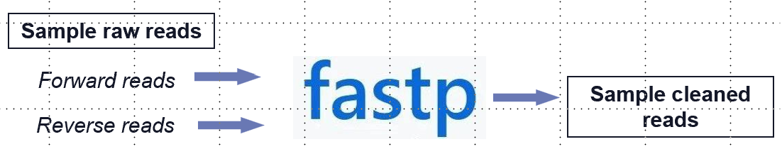
Step 1 (QC)
Quality control for sequenced patient samples (FASTQ) files
Removed low quality reads both in terms of length and quality score
Removed low complexity regions
Default 15
Lost ~177k reads in WUH1
Lost ~153k reads in WUH2
Generated html reports
Learnings
This was not mentioned in the paper, no thresholds given
Initially did with FASTQC then shifted to fastp as it’s less complex and fast
Results were similar when compared

Slide 14
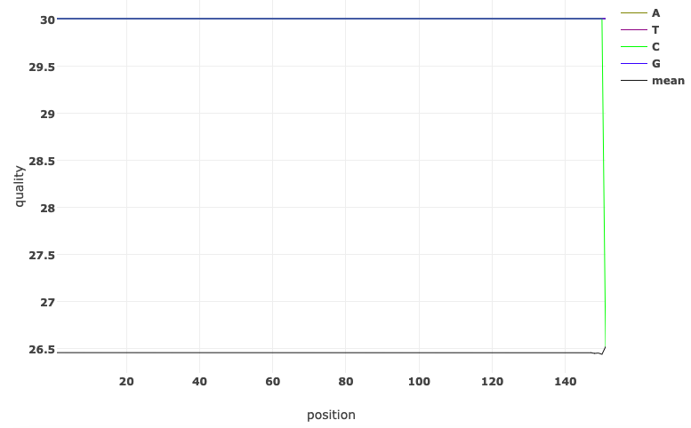
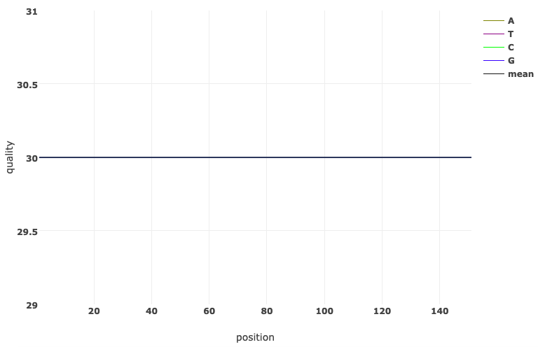
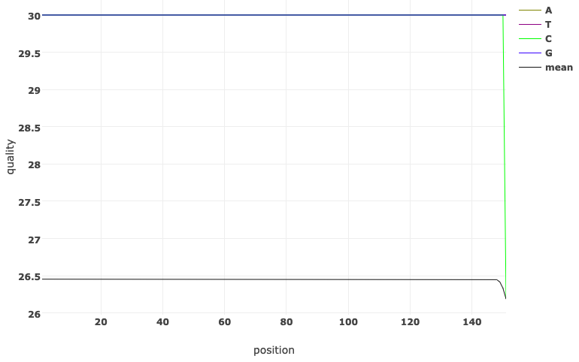
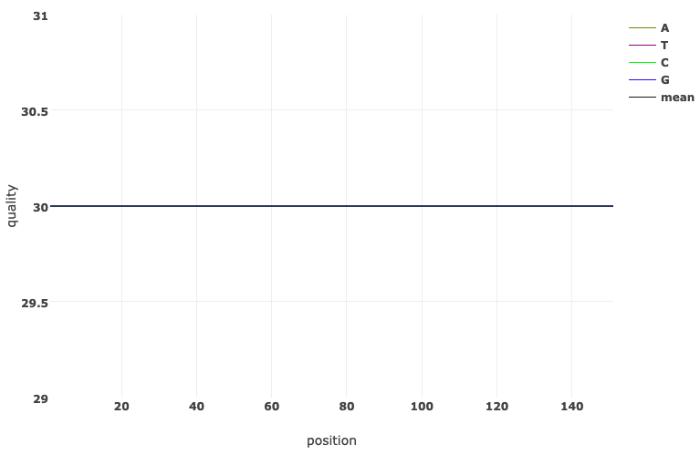
QC Wuhan 1 Report
Before filtering: read quality
After filtering: read quality
1
2

Slide 15
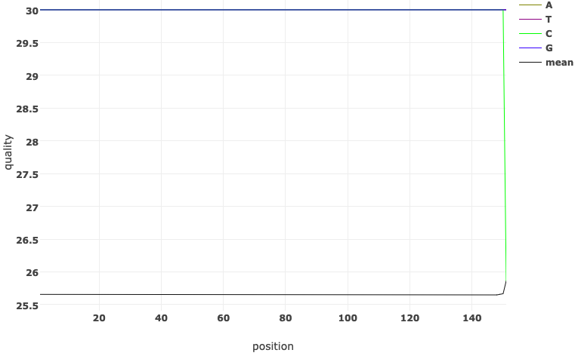
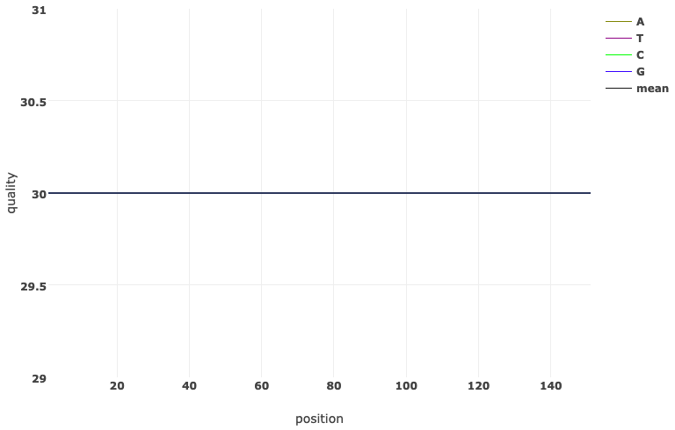
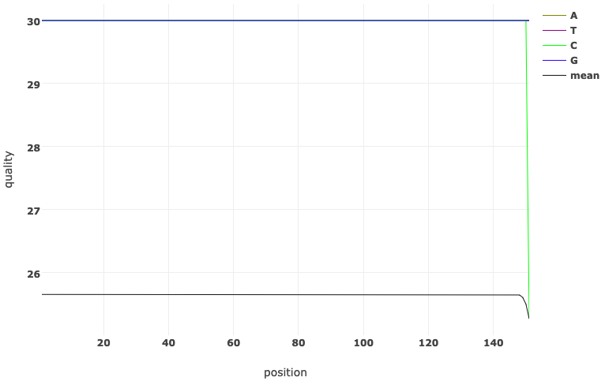
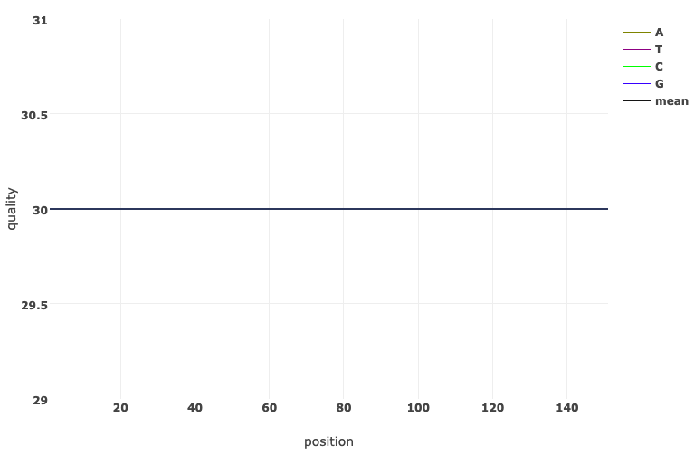
QC Wuhan 2 Report
Before filtering: read quality
After filtering: read quality
1
2

Slide 16
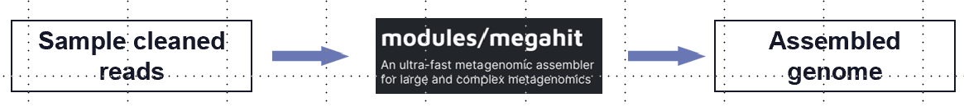
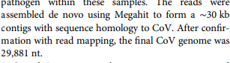
Step 2,3 (Get hits from blastn and assemble genome)
Assembly is done using MEGAHIT to get
Similar results were obtained for both the samples
Final CoV genome was around 30k nt ( as in original paper)
Learnings
There were memory issues for blast due to big reference genomes
Got over it by using blast cmd for getting reference FASTA files
Contigs were generated more when done with raw files rather than assembled genomes however results were same

Slide 17

Step 4 (Viral taxonomic profiling)
Sub-step 1:
Sample final contigs
Blastn hits
Top contigs
Sub-step 2:
Blastn hit / Top contigs
Accession number of hits
Taxonomic ID of hits
Sub-step 3:
Taxonomy database
Taxonomic ID of hits
Sample Lineage

Slide 18
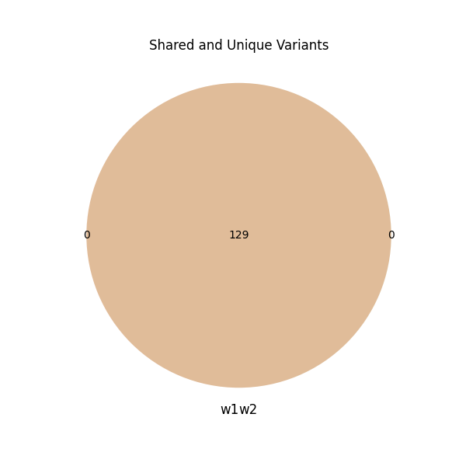
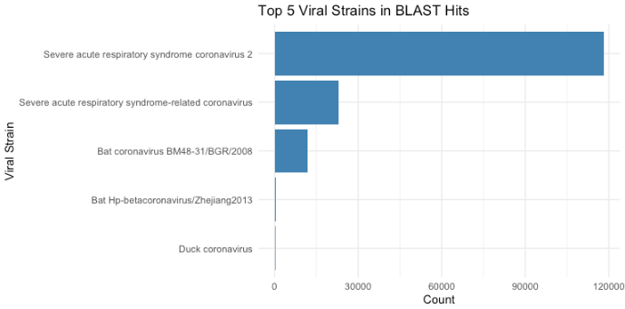
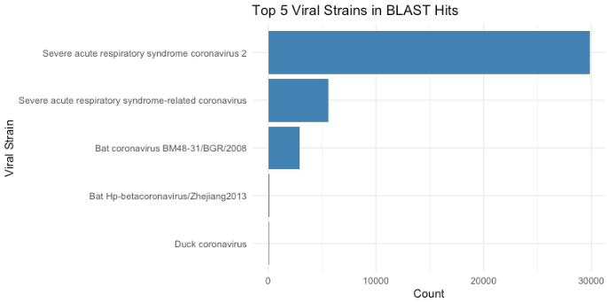
Differences between WUH1 and WUH2 genomes
Wuhan 1
Wuhan 2
Consensus genome sequences obtained from the patient 1 and 2 were identical but had minor variations between them. These results indicated that these two individual patients were infected by the same CoV at separate times

Slide 19
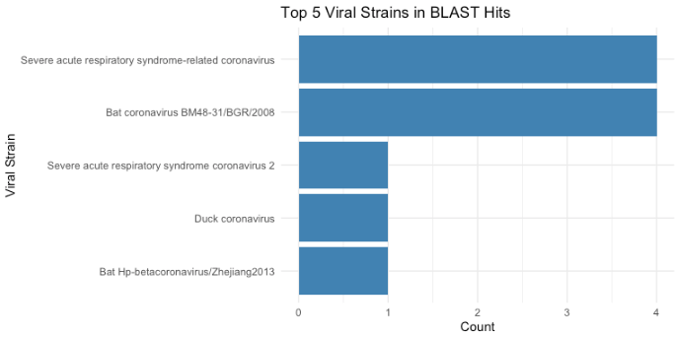
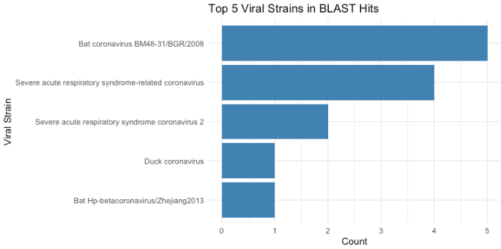
Taxonomic profiling using top contigs
Wuhan 1
Wuhan 2

Slide 20

Taxonomy classification (Bacterial)
Initially attempted with MetaPhlan2 as suggested in the paper
Not able to replicate it
Depreciated version
Alternatives
Kraken2 and Kaiju ( much faster and reliable)
Used Kraken2 for further
Sample final contigs
Taxonomic profile report

Slide 21
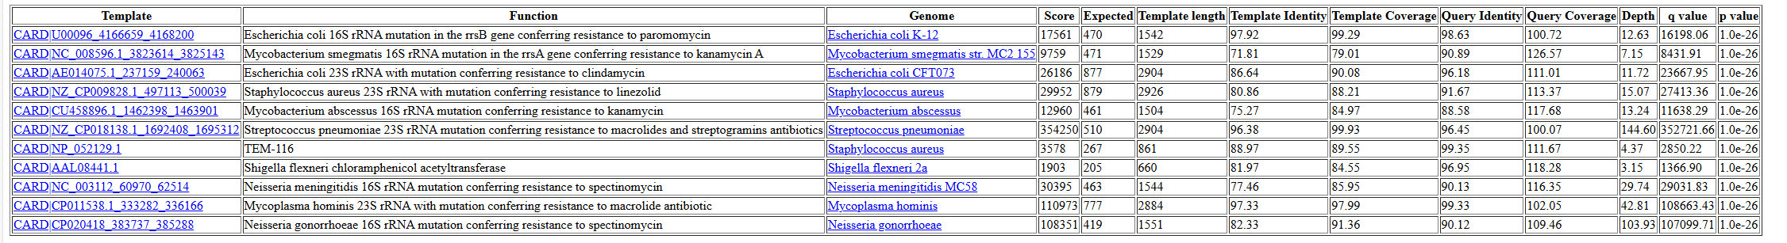
Bacterial taxonomy(kraken2)
Wuhan 1
Wuhan 2
Additional bacterial species were found only in sample2 but those are not pathogenic hence concluded SARS-CoV-2 as the primary pathogen for further analysis

Slide 22
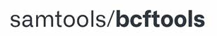
Mapping, consensus and variant calling
Sub-step 1:
Sample cleaned ( fastq )
Sample mapped reads (sam file)
Reference virus index
Sub-step 2:
Sample mapped reads (sam file)
Mapped and sorted bam file
Sub-step 3:
Mapped and sorted bam file
Variant calling matrix

Slide 23

Step 5 ( Phylogenetics-prep)
Sub-step 1:
Sample top contig
Aligned sequences (fasta)
Viral reference genome
Sub-step 2:
Aligned sequences (fasta)
Aligned sequences (phy)

Slide 24
Step 5 ( Phylogenetics)
After aligning -------- input for tree
Implemented using IQ tree and PhyML
Python based script to visualize the trees rather than relying GUI’s
Aligned sequences (phy)
Phylogenetic tree files

Slide 25
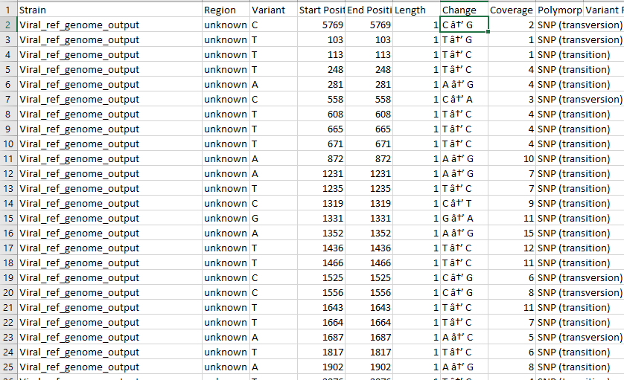
How to identify whether it’s a new strain??
Two Patient samples were similar
The paper proceeded straight to phylogenetics
We wanted to see how different are these two from the reference genome
SNP profile between patient samples and reference genome
This might be the reason why SARS-CoV-2 specific tests gave negative results
However, these changes were not that frequent
Lessons:
Coverage was less, it may get better if we have used annotated files
Even phylogenetics showed much closer relations, so this is acceptable

Slide 26
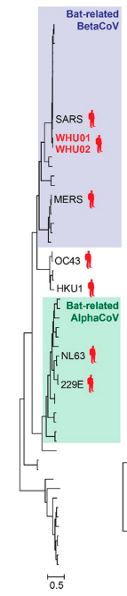
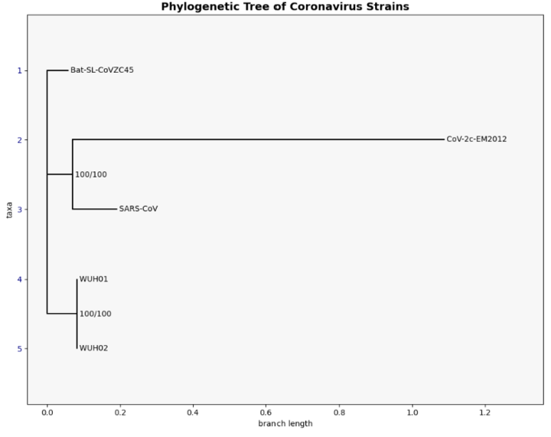
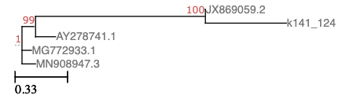
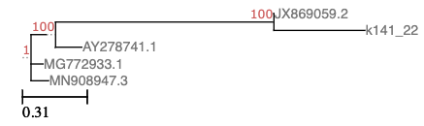
Phylogenetic Tree
Generated
Original
https://etetoolkit.org/treeview/
Learnings
The tree was different in terms of visualization as human related sequences were already removed
Similar interpretation can be seen in terms of being related to bat SARs-Cov-2

Slide 27
Conclusion
In an outbreak with unknown etiology, we report the use of RNA based mNGS approach for a rapid identification and characterization of a potential pathogen (novel)
Important for disease control and prevention
Collectively, these results use the rich information present in the RNA metagenomics to evaluate potential pathogens
Highlights a future trend of viral diagnosis that is currently being used for infectious disease surveillance

Slide 28
Takeaways
Importance of documentation
Solving dependency conflicts
Able to use Unix/ bash skills for writing scripts
Used R, python custom scripts for visualization
Handled memory issues
Effectively used HPC, Jupyter notebook, Nova on Demand

Slide 29


Our Experience

